Slide 1
Works
1
Graph neural network as third biomarker prediction model
2
Generative AI competition
Others
1
Electric Circuits TA works

Slide 2
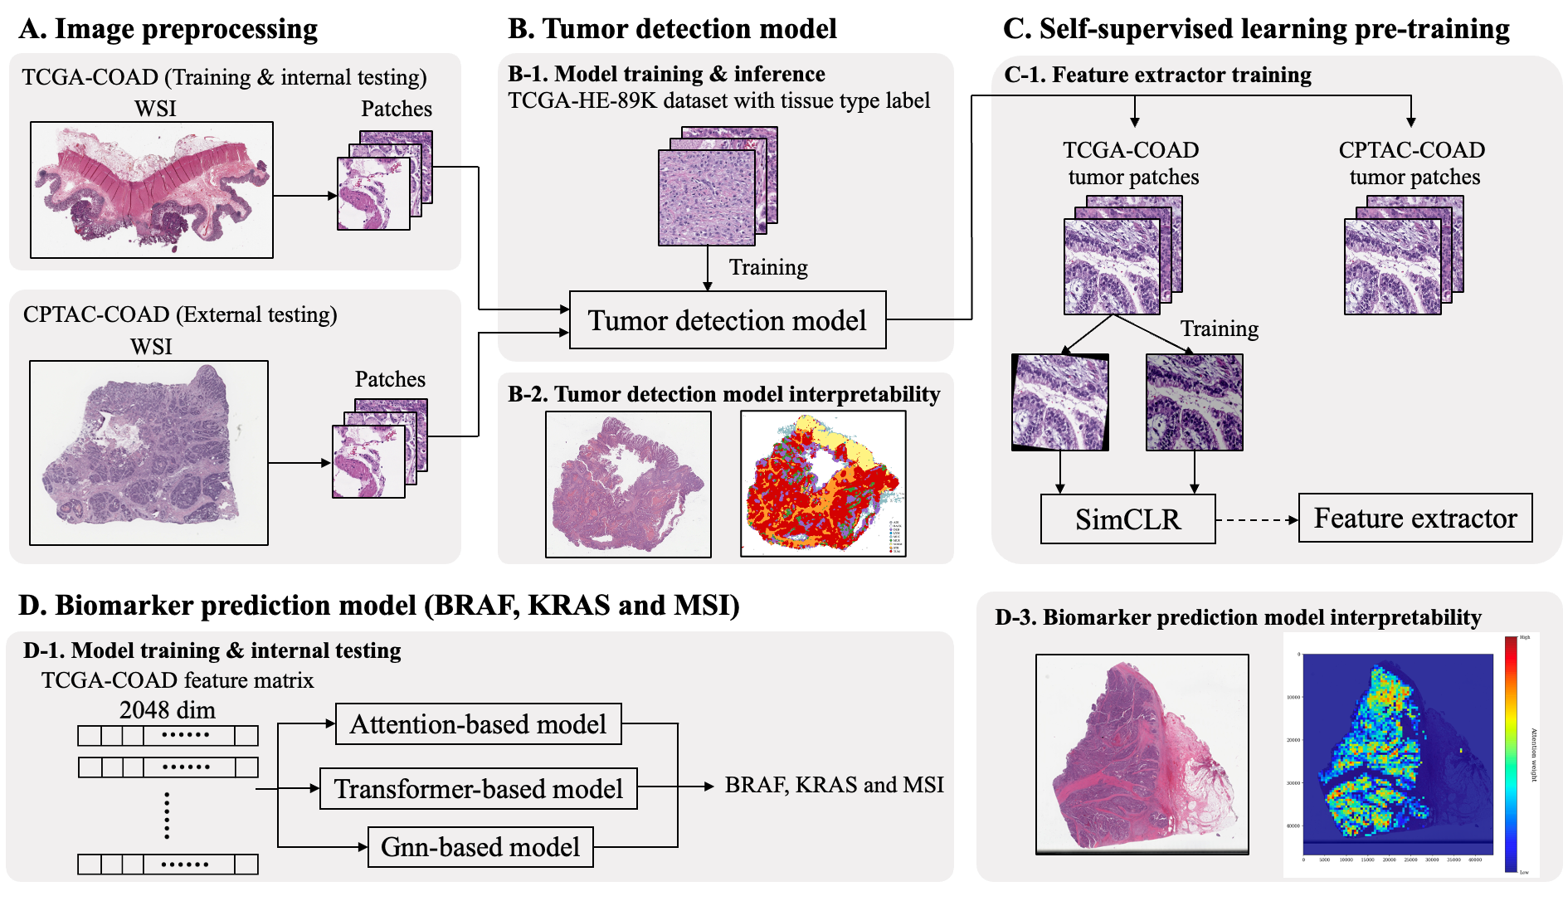

Slide 3
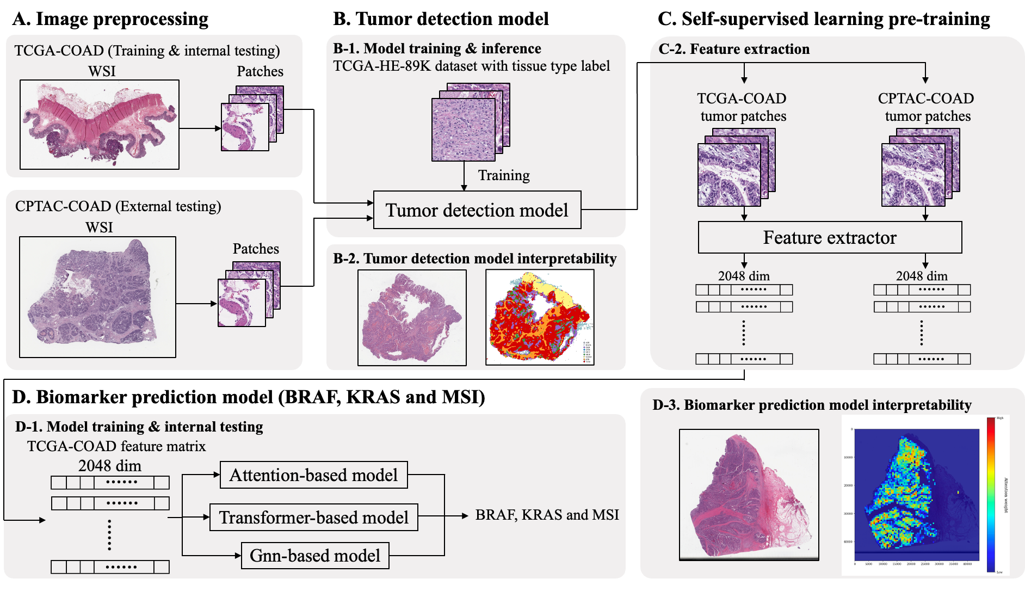

Slide 4
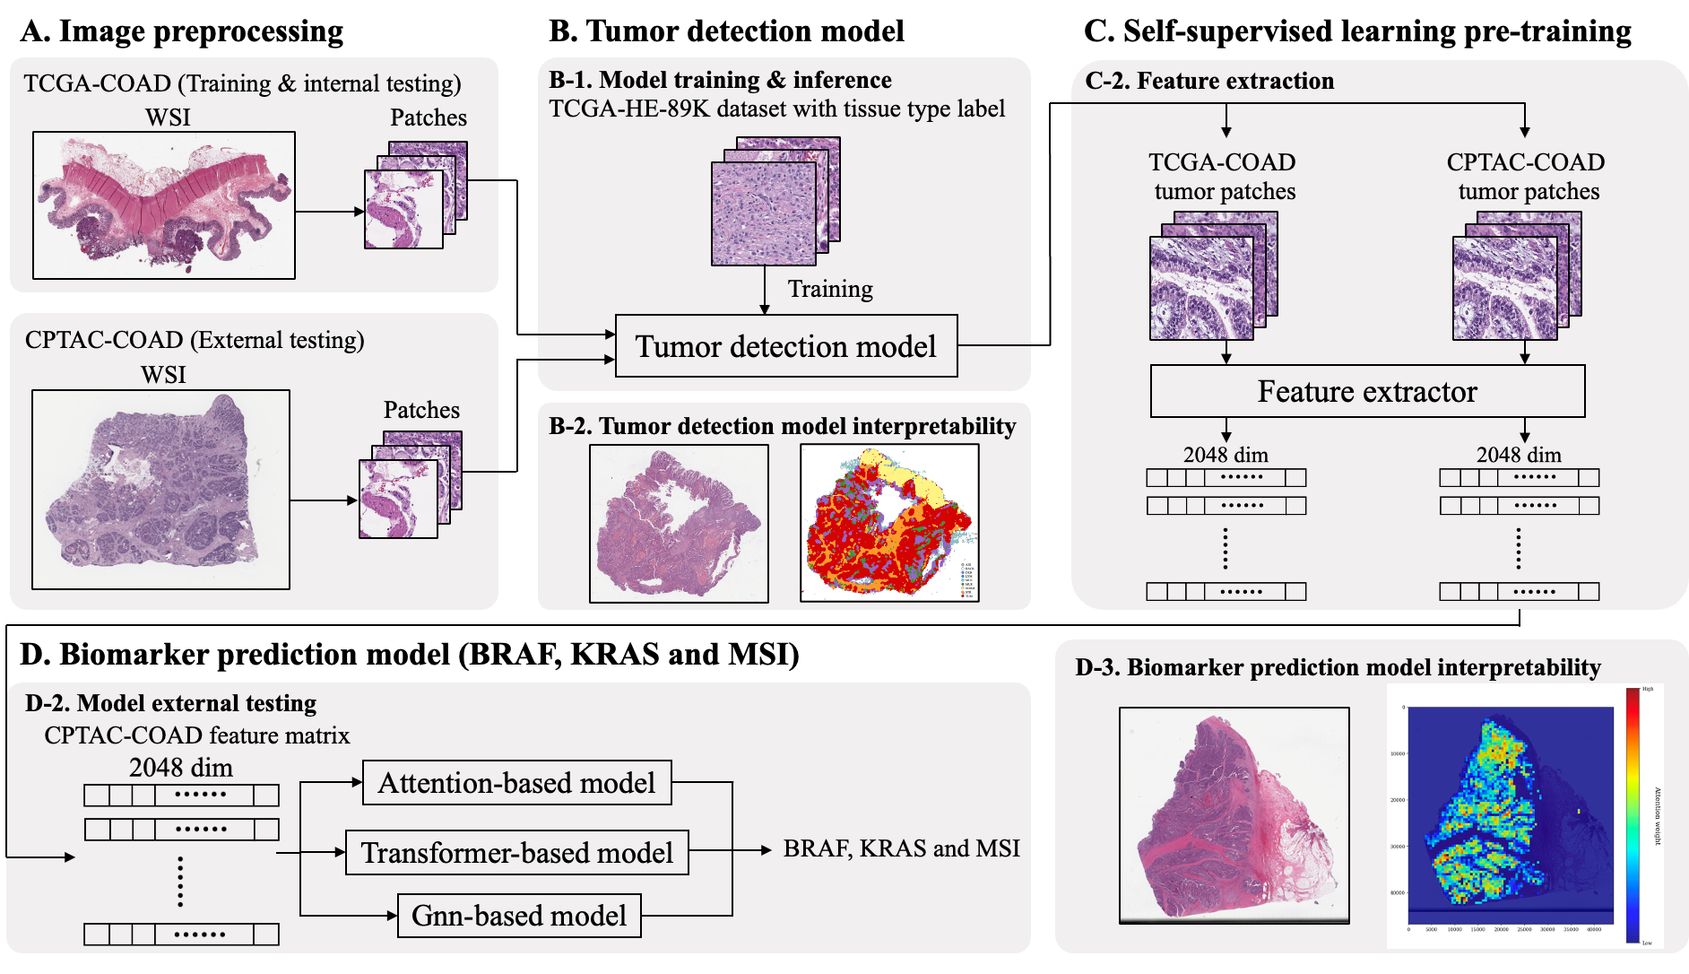

Slide 5
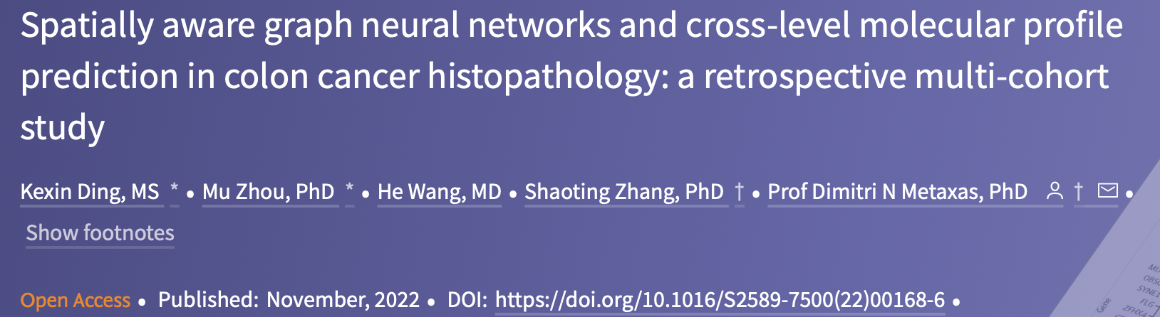
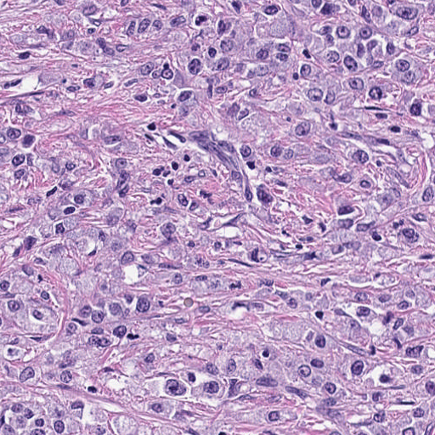
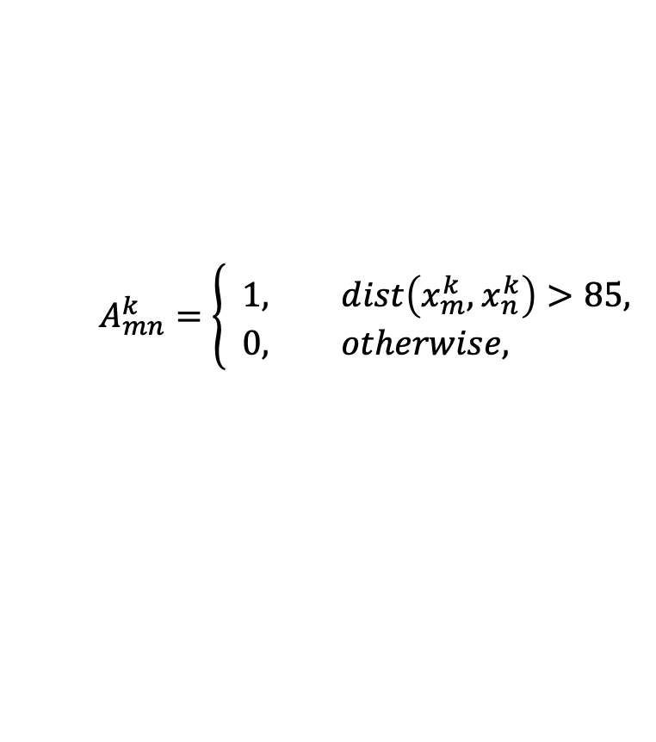
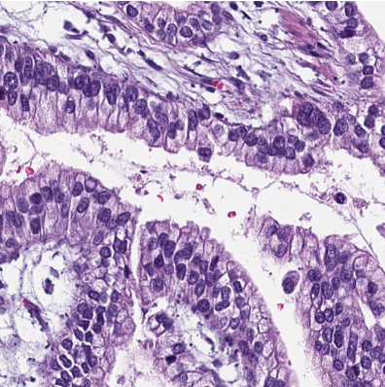
Graph neural network
Clarify doubt of the previous paper:
- what is the basis for establishing an edge between the two vertices?
(x_{j} , y_{j})
, where dist() is Euclidean distance
(x_{i} , y_{i})

Slide 6
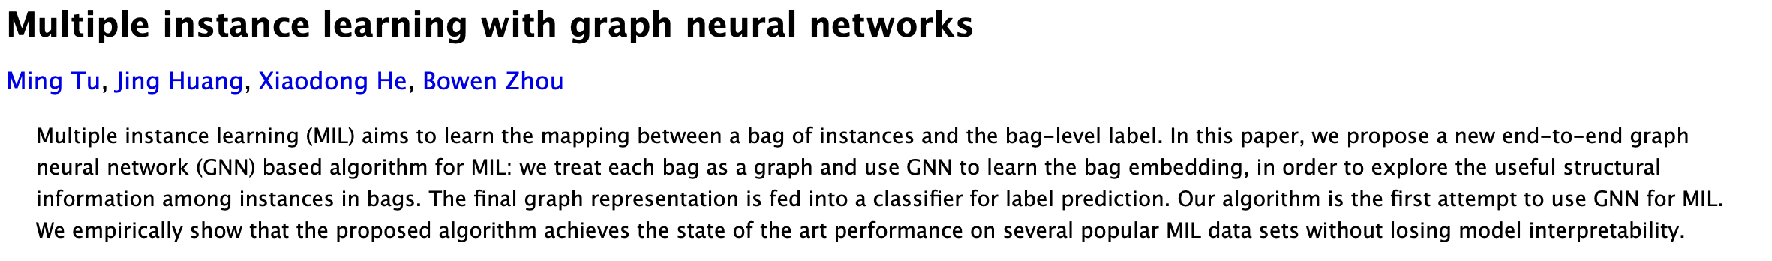
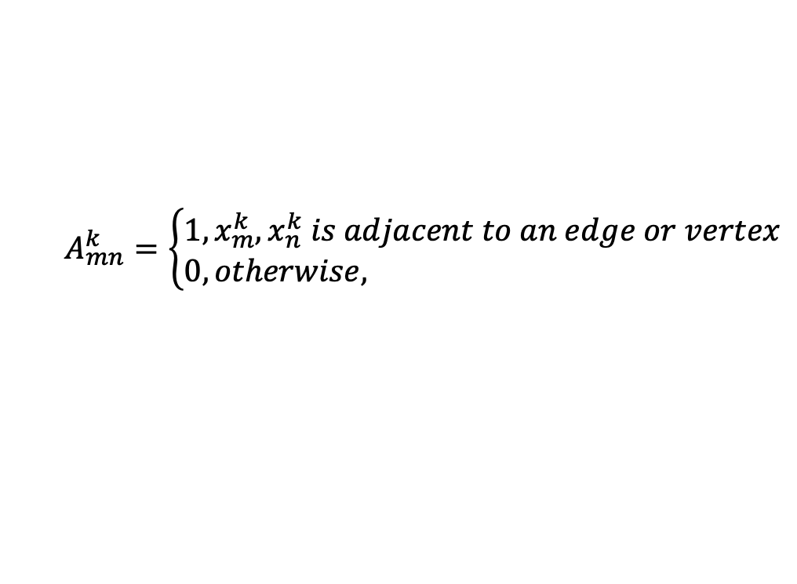
Graph neural network
Clarify doubt of the previous paper:
- what is the basis for establishing an edge between the two vertices?
(x_{j} , y_{j})
1
2
(x_{i} , y_{i})

Slide 7
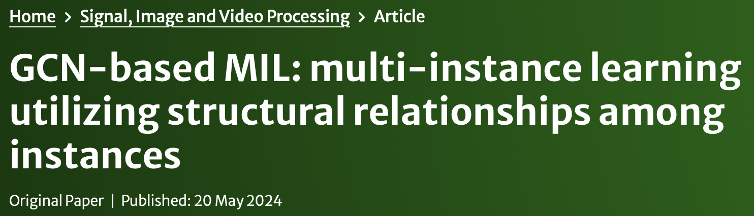
Graph neural network
Clarify doubt of the previous paper:
- it will randomly divide one graph (WSI) into five subgraph and use ensemble learning to aggregate
- Is random selection a reasonable method?
Try to regard these question as multiple instance learning problem

Slide 8
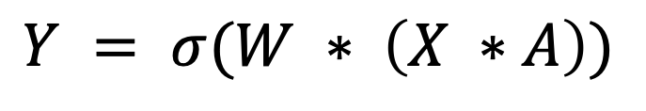
Graph convolutional network, GCN
 | 1 |  | 1
1 |  | 1 | 1
 | 1
1 | 1
x_{1j} | x_{2j} | x_{3j} | x_{4j}
x_{1j} | x_{2j} | x_{3j} | x_{4j}
=
,
Graph
Feature matrix
Adjacency matrix
X: feature matrix
A: adjacency matrix
W: convolutional kernel weight, which it is trainable
𝜎: activation function

Slide 9
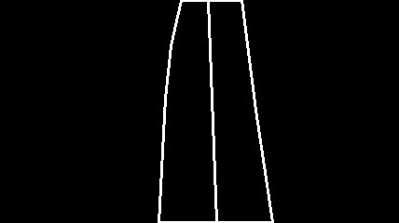
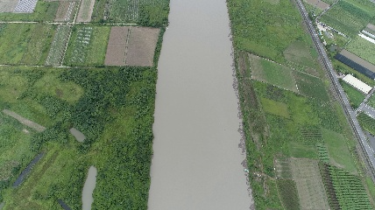

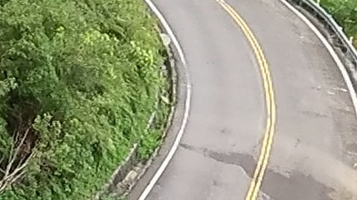
Generative AI competition
Aim: use Generative AI to generate drone aerial image from image contour label
River
Road

Slide 10
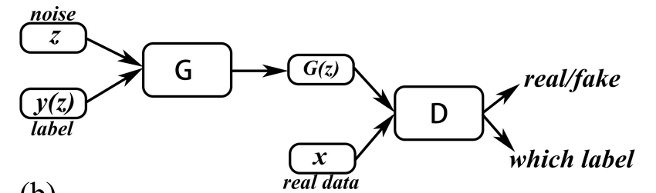
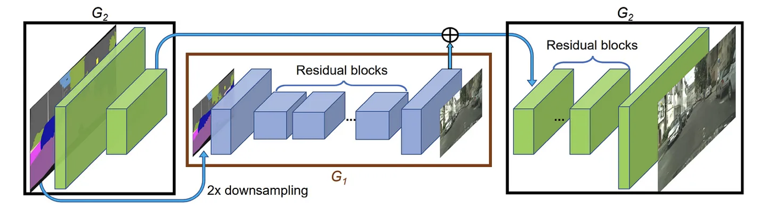
Generative AI competition
Method: pix2pix
Literature reference: Wang, Ting-Chun, et al. "High-resolution image synthesis and semantic manipulation with conditional gans." Proceedings of the IEEE conference on computer vision and pattern recognition. 2018.
Conditional GAN: cGAN is a variant of the GAN that incorporates conditional information into the model. There are two model which is generator and discriminator, trained simultaneously through a process where the generator tries to create realistic data instances while the discriminator tries to distinguish between real and generated instances.

Slide 11
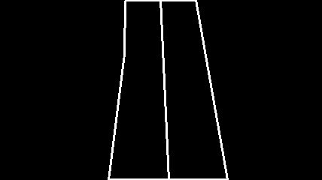
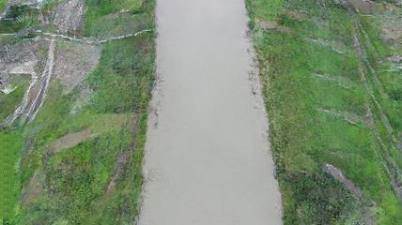

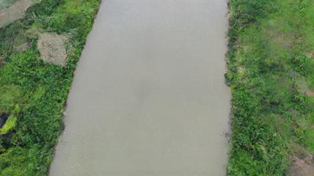
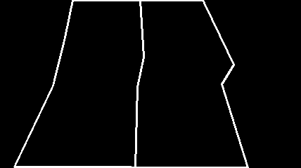
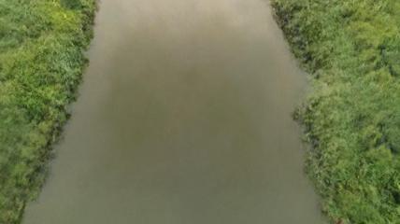
Generative AI competition
RIVER

Slide 12

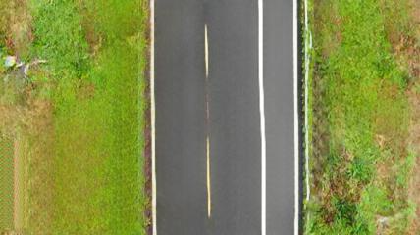



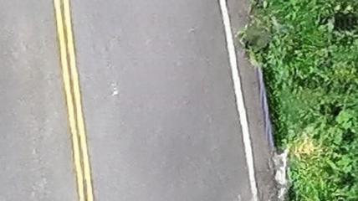
Generative AI competition
ROAD

Slide 13
Future works
1
Training GNN of biomarker prediction

